Slide 1
Foxcore Retail Case Analysis
Presented By:
Hetal Virendrabhai Gandhi
Akanksha Shrivastava
Anandi Singh
Unnati Agrawal
Diana Nyaama Asilga
Jahnvi Kansara

Slide 2
Index:
Introduction
Problem Statement
Objective
Proposed solution
Database Design
Normalization
DDL Statements
Insert, update and delete Statements
Select Statements
Strategic Benefits and Potential Challenges
Conclusion

Slide 3
Introduction:
Foxcore Retail is a small retail business founded by business partners Liam Corrigan and Mitchell Fox. The company specializes in selling inexpensive novelty items at music festivals and trade shows across Ontario.
Problem Statement:
Manual sales tracking and Excel use caused admin burden, data errors, and redundancy. Commission calculations were inefficient, insights limited, and inventory estimates inaccurate. Growing operations highlighted the need for a robust database system.

Slide 4
Objective:
The purpose of this project is to design and implement a robust database system to address Foxcore Retail's data management challenges. The key objectives are to:
Enable efficient tracking of events, sales consultants, and product sales.
Improve the accuracy and reliability of sales data.
Provide strategic insights to support better decision-making.
Proposed Solution:
The proposed solution is to design and implement a custom relational database system. This database will centralize and organize Foxcore Retail's data, enabling efficient data retrieval, analysis, and reporting

Slide 5
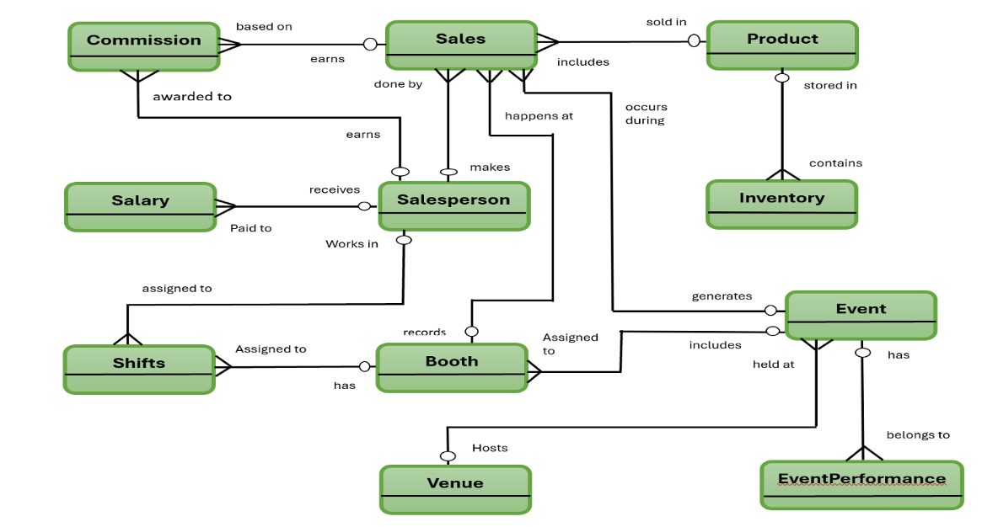
Database Design:

Slide 6
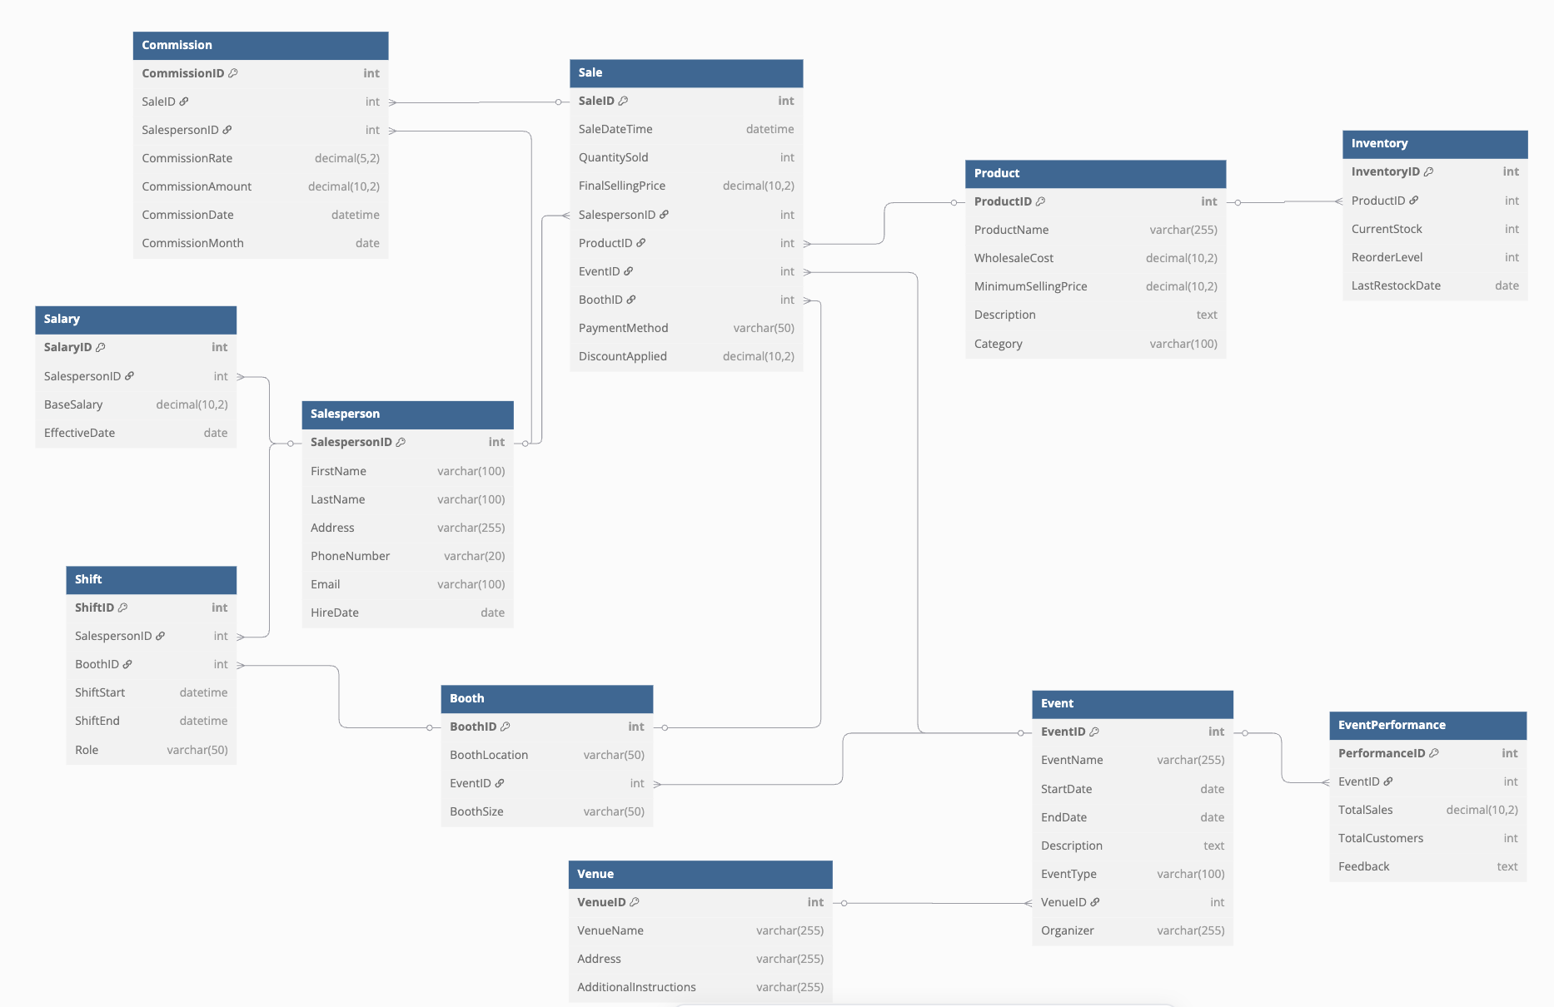
Relational Database Schema :

Slide 7
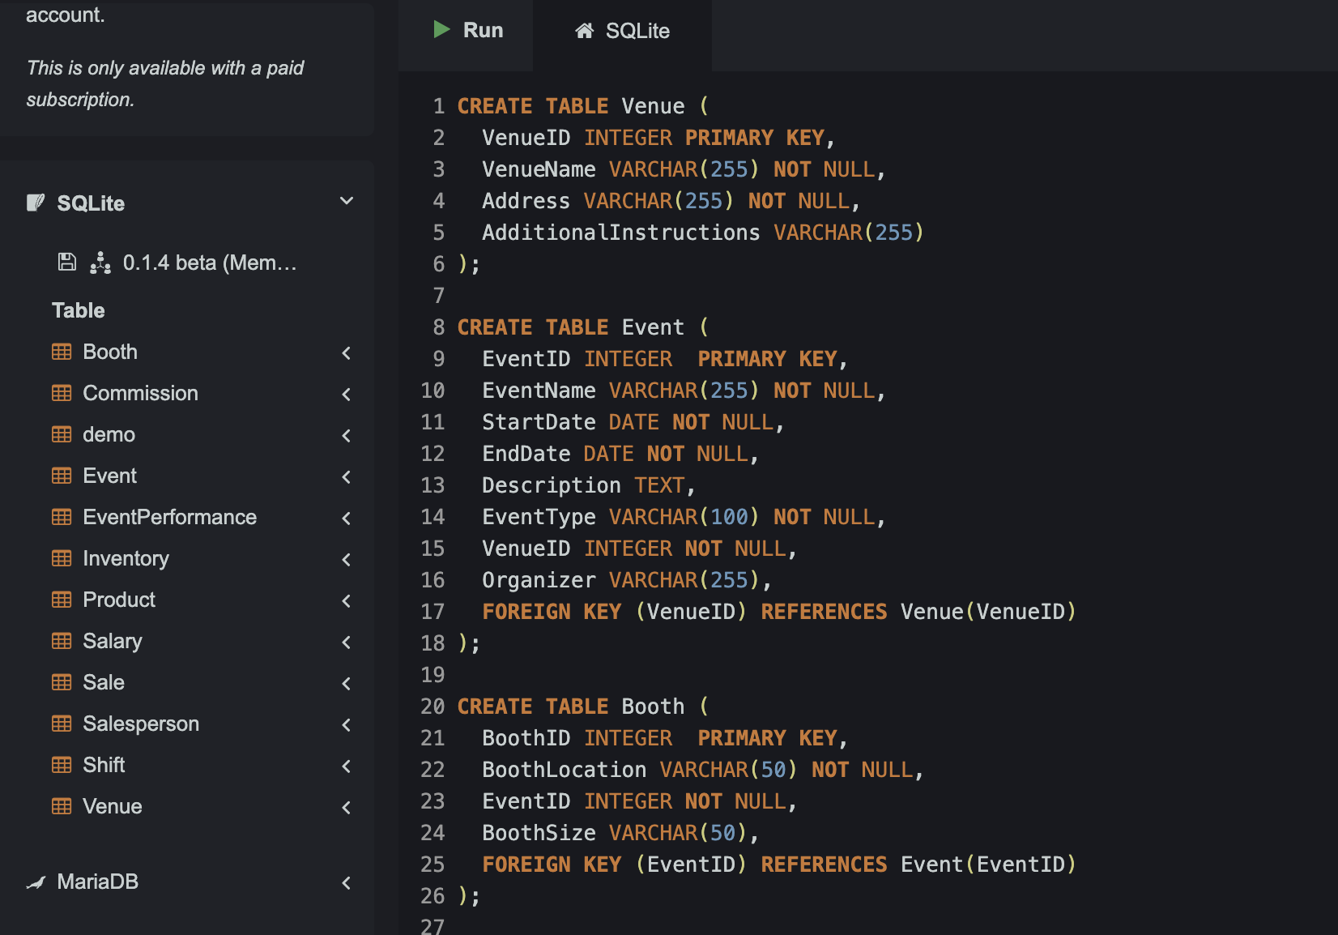
DDL Statements - Create Command :

Slide 8
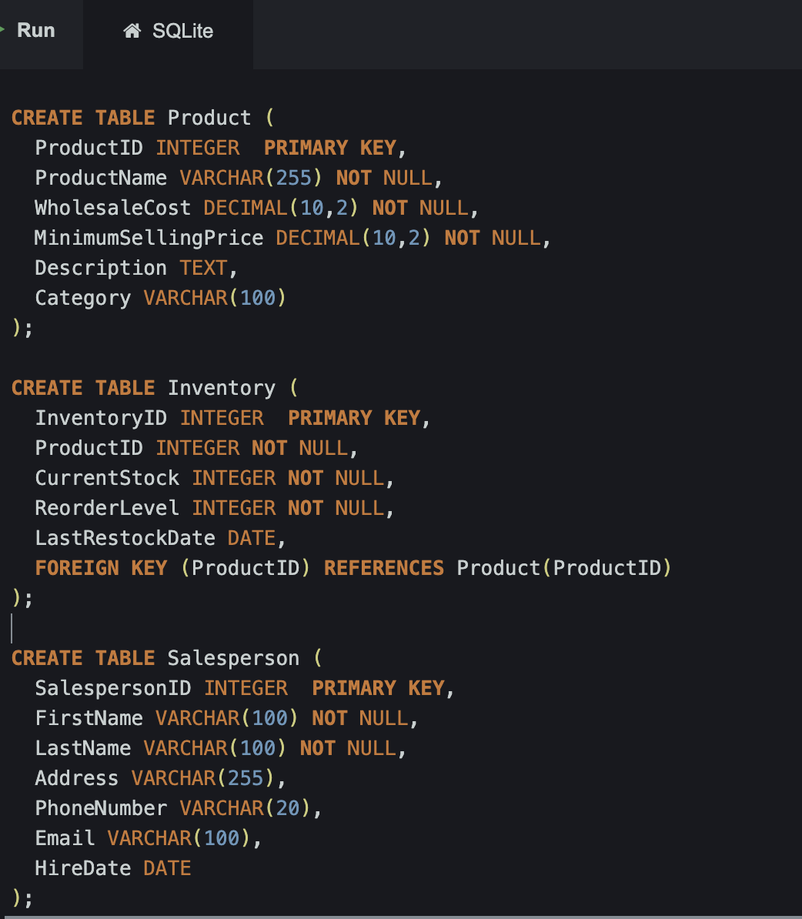
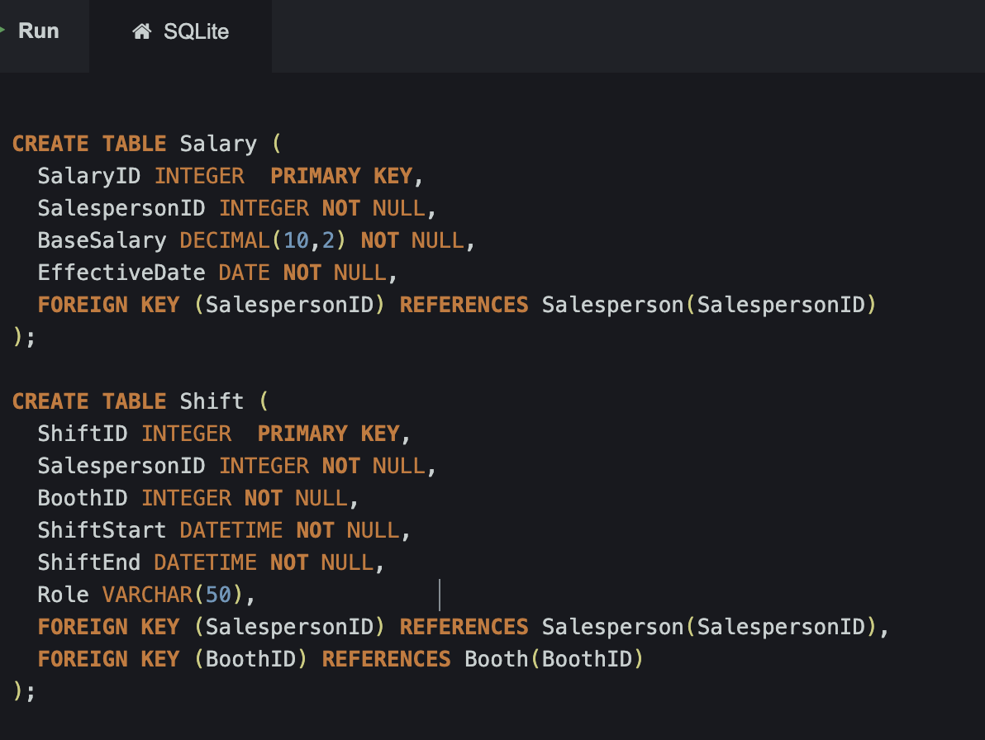

Slide 9
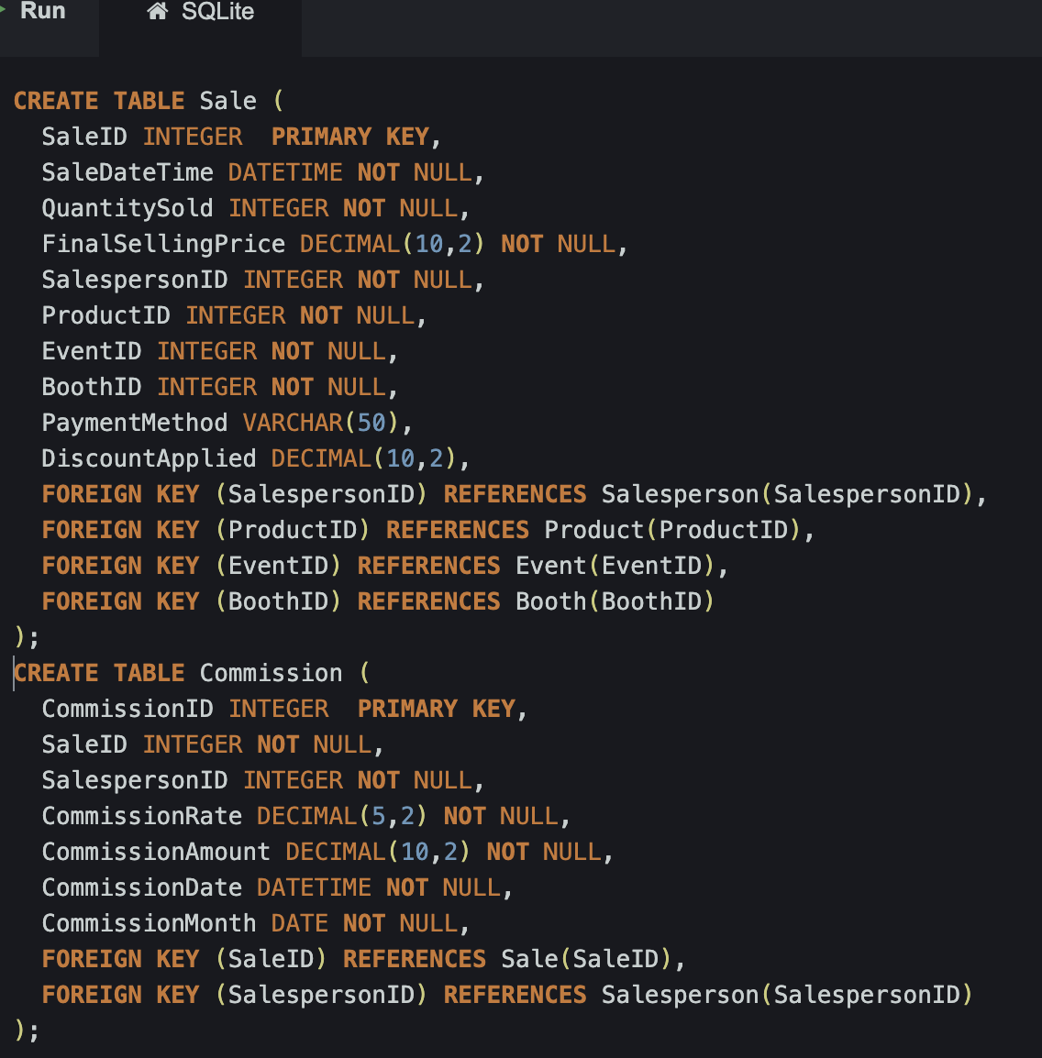
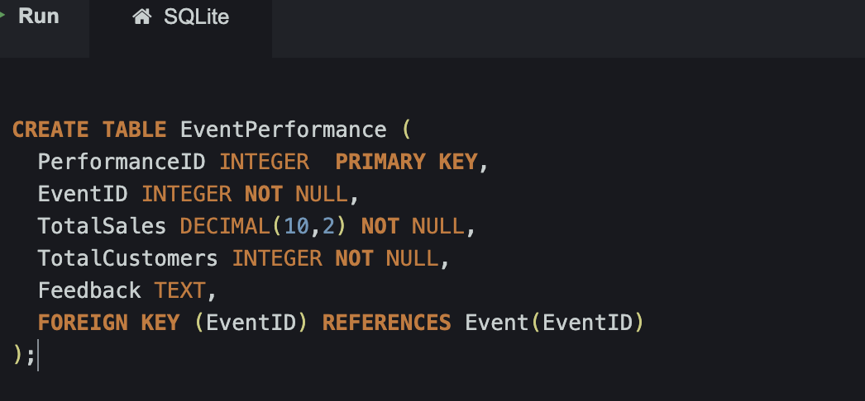

Slide 10
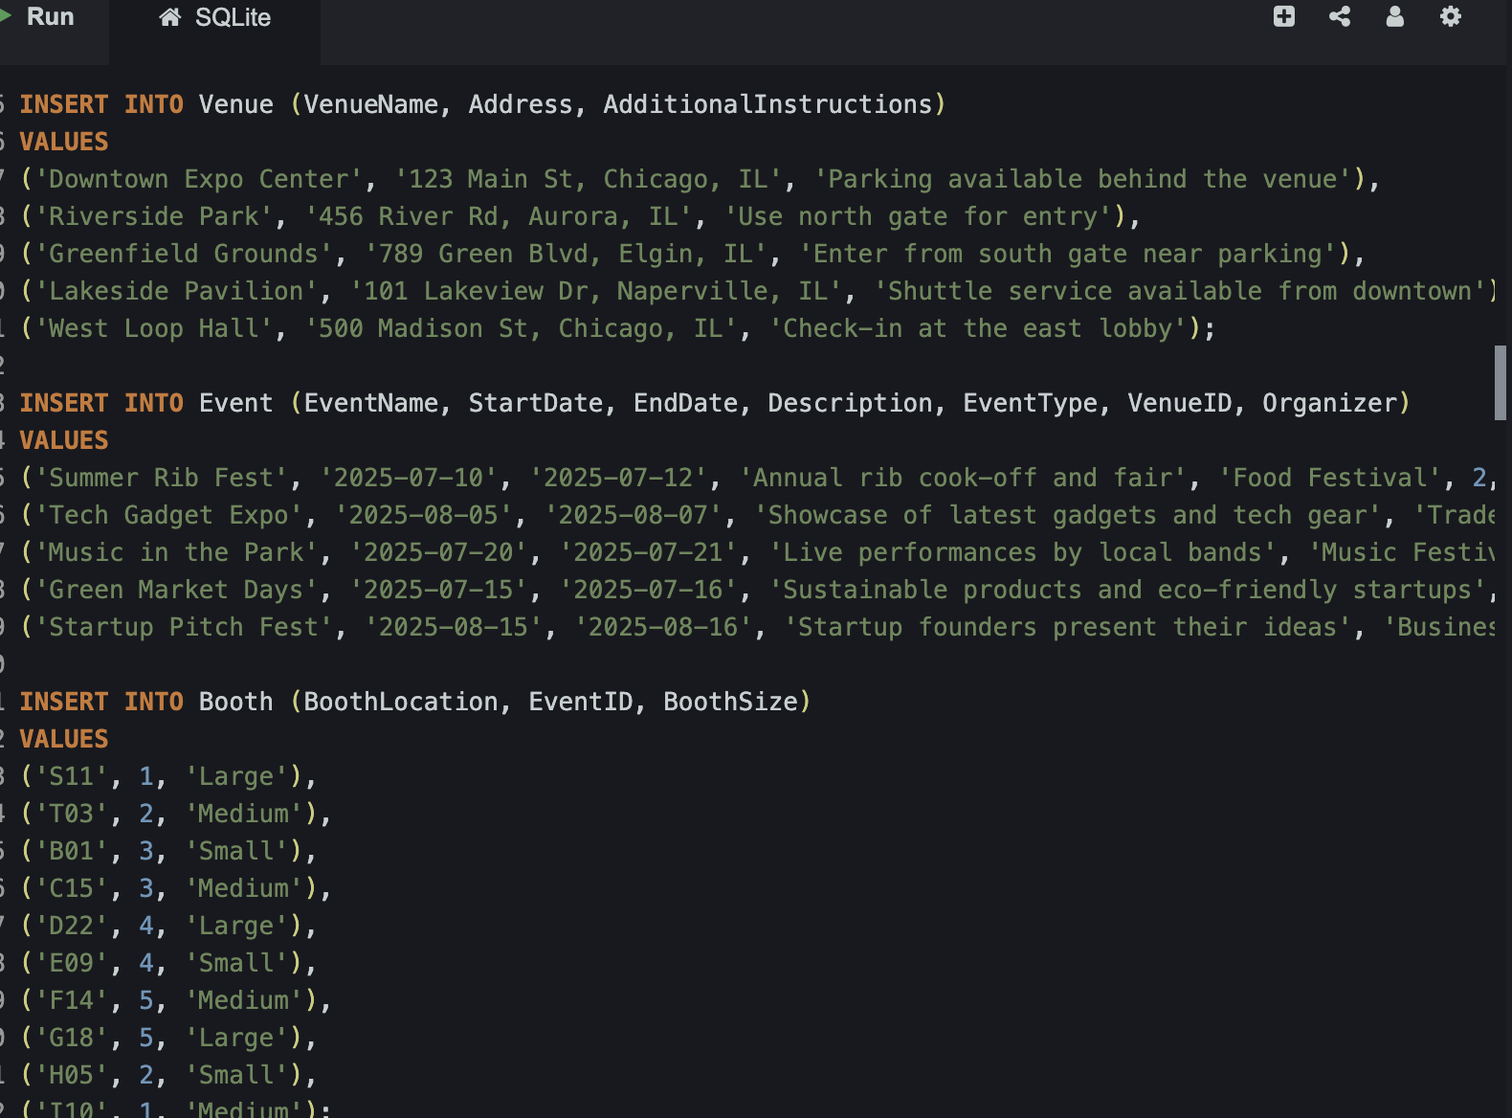
Insert, Update And Delete Statements :

Slide 11
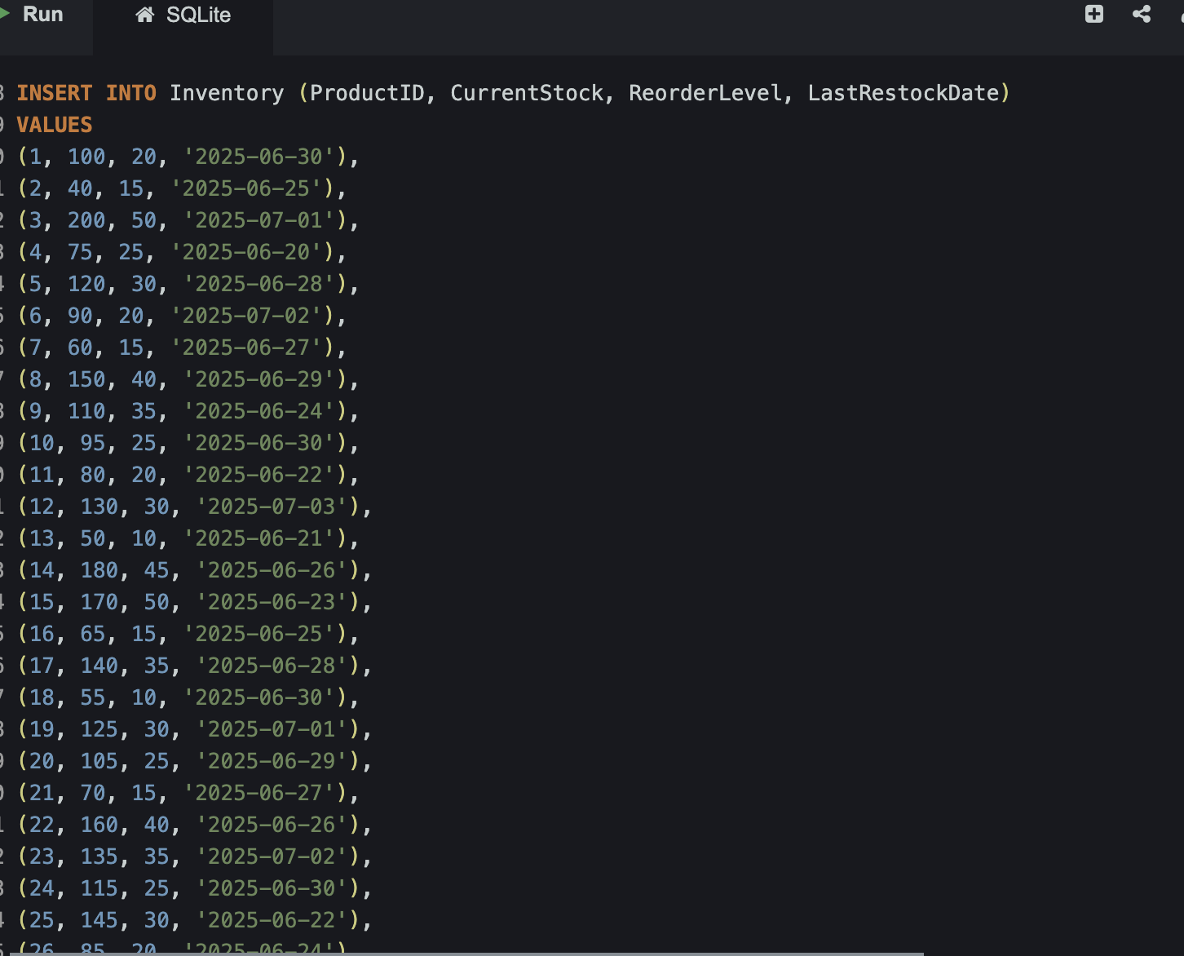
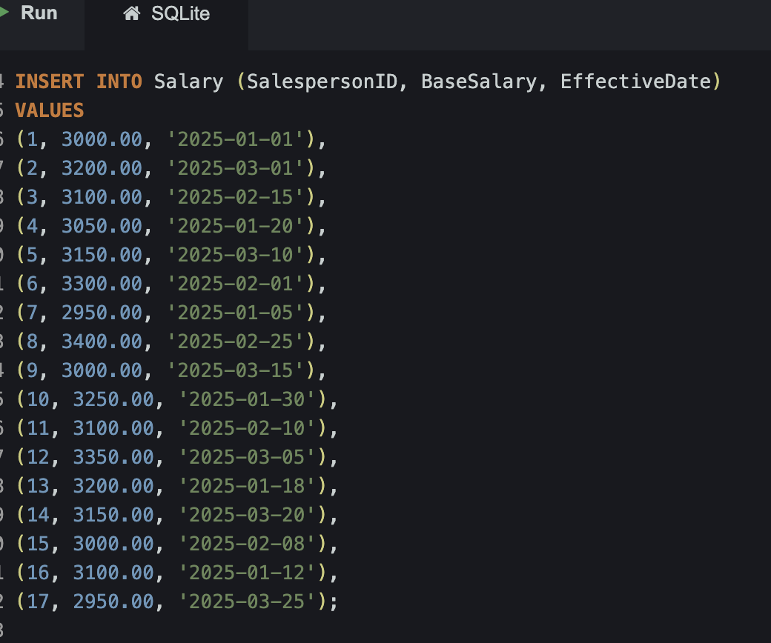

Slide 12
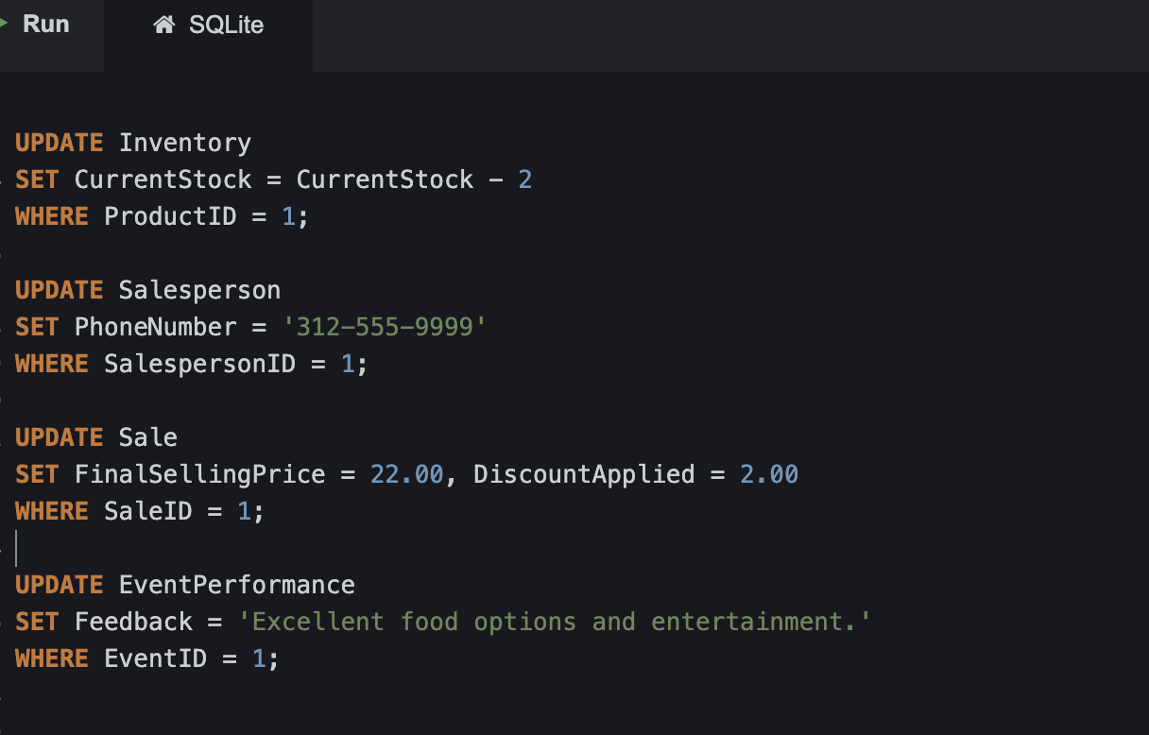
Update Statement:

Slide 13
Delete Statement :

Slide 14
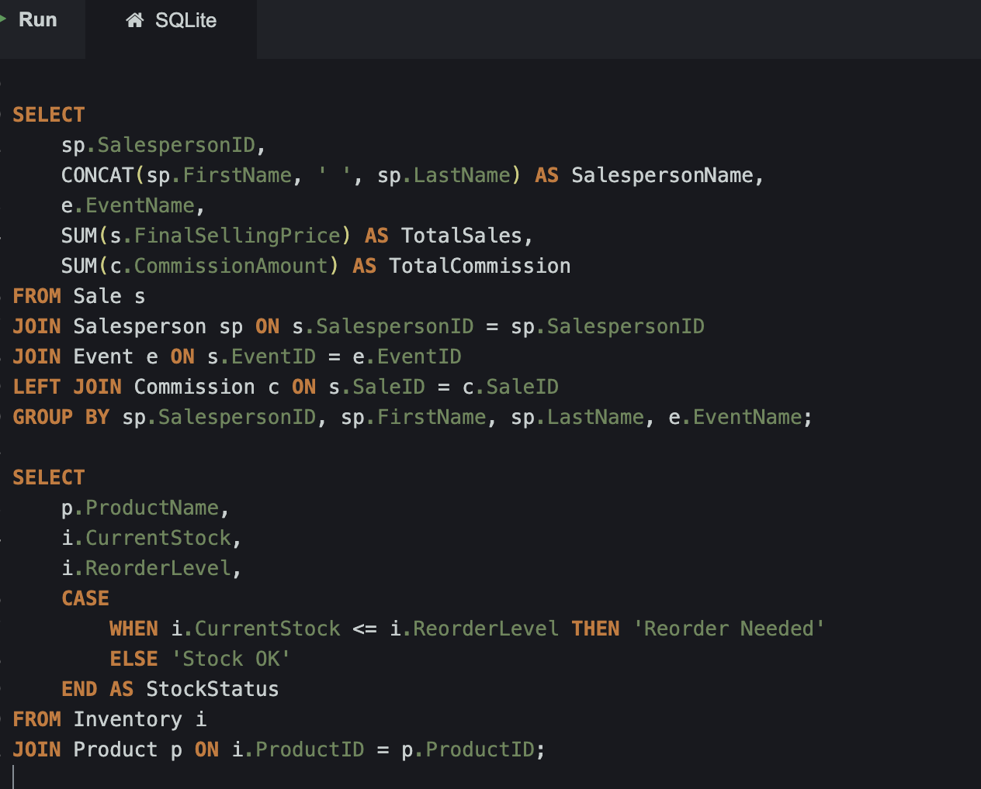
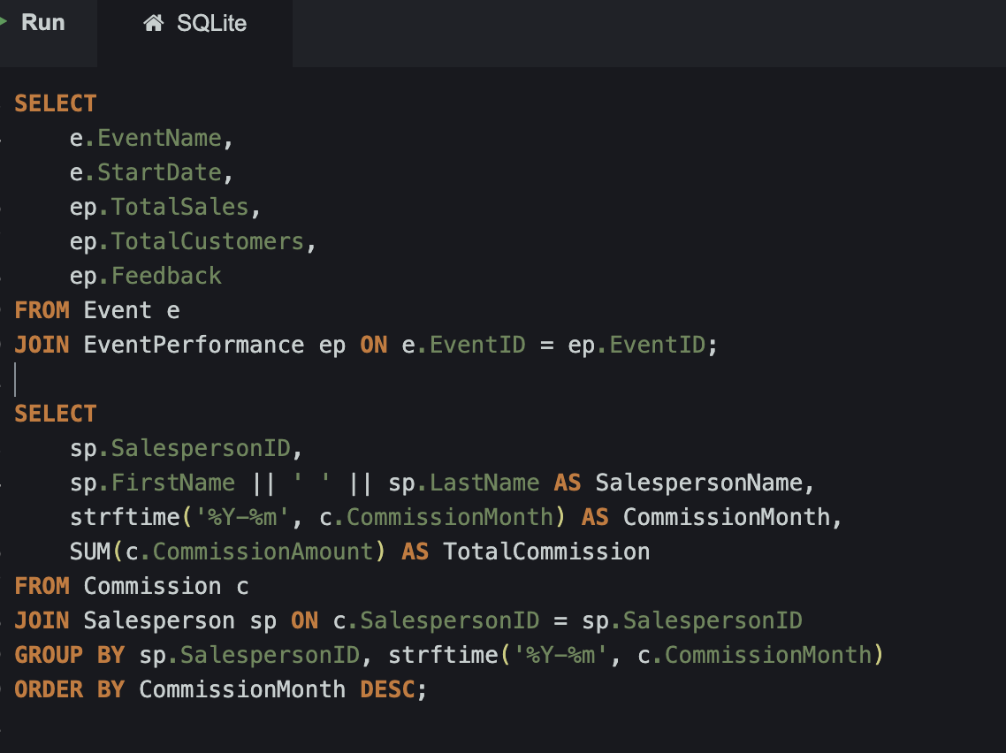
Select Statements :

Slide 15
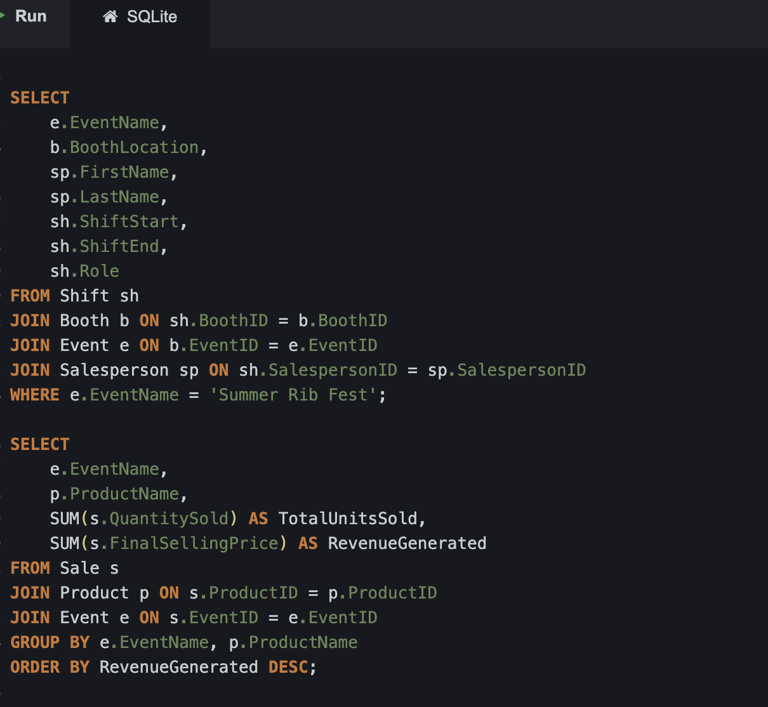

Slide 16
Strategic Benefits:
Automated and accurate calculation of sales commissions.
Improved tracking of sales performance by salesperson, product, and event.
Enhanced inventory management to prevent stockouts and overstocking.
Better understanding of product performance and sales trends to inform business decisions.
Streamlined administrative processes and reduced errors.
Technical Challenges:
Designing and implementing the database schema correctly based on the provided model.
Ensuring data integrity and consistency during data migration and ongoing operations.
Developing efficient SQL queries for reporting and analysis.
User training and adoption of the new database system.

Slide 17
Conclusion:
This document provides a comprehensive database design for Foxcore Retail, leveraging the provided ER Diagram and schema. The proposed solution addresses the company's need for a robust system to track events, sales consultants, and product sales. By implementing this database, Foxcore Retail can overcome its current data management challenges, improve operational efficiency, and gain valuable insights for strategic decision-making.

